Slide 1
Python for Beginners
Keno Catabay
Graduate Assistant
kc13af@my.fsu.edu

Slide 2
Upcoming Events

Slide 3
why are y’all interested in learning python?

Slide 4
what we’ll cover today
Basic Python vocabulary
Some hands-on with creating variables
Simple operations with numbers and strings
Intro to for-loops
Intro to if, else statements
A few exercises
Additional resources

Slide 5
what this isn’t
An exhaustive look at all of the functionality of Python
That would be impossible
An overview of the different libraries or modules
An in-depth look for people who already have some experience with Python

Slide 6
Why use Python?

Slide 7
why use python?
Object-oriented programming language
“High level” - meaning that it reads a lot more like a human language than a computer language
Works well with a lot of different types of data (any plaintext data, including text, csv, json, xml, etc.)
A LOT of modules/libraries already developed and ready-to-use

Slide 8
what you can do with it (a sampling)
Analyze data from CSVs and other tabular data formats
Scrape the web
Text analysis (e.g. with the Natural Language Toolkit, NLTK)
Clean and batch-edit data
The sky’s the limit

Slide 9
a note
Like most languages, Python continues to add new features and update itself. The most recent version of Python is Python 3, but Python 2 is is still in common usage. If you are writing a program in Python, check to make sure that the reference book/forum/resource that you are using to learn is talking about the same version that you are using!

Slide 10
Let’s get y’all set up

Slide 11
dhbox
Set up an account at http://dhbox.org if you haven’t already!

Slide 12
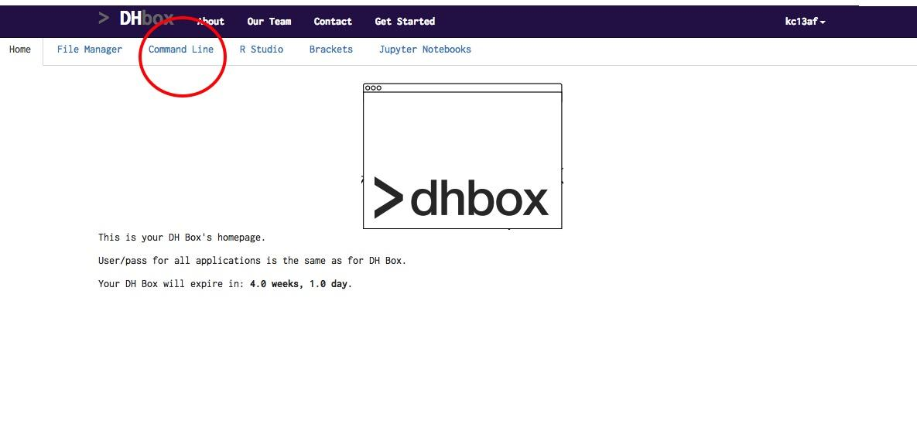
today we’ll use
The command line
Jupyter Notebooks

Slide 13
python interpreter
Using the command line as a python interpreter
Type commands directly into the Terminal
python3

Slide 14
Vocabulary & Concepts

Slide 15
variables
Variables basically allow you to “name” entities so that you can refer to them later
To create a variable you use the “=” sign
This is called “assignment”
`variable_name = [insert variable here]`
test = 123

Slide 16
dealing with text and numbers
Generally, if you assign a variable that is all numbers, Python will assume that you want to work with integers.
Put variables in “quotes” if you want the variable to be interpreted as a string
String - defined by either single quote or double quotes

Slide 17
create some test variables
Try creating variables with the following names:
Keno = “python instructor”
cat = “dog”
cat = dog

Slide 18
Simple operations with numbers and strings
Simple operators can be executed on numbers and strings
one = 1
two = 2
three = one + two
print(three)
Try: print(four)
What happened?
Try: print(4)
What happened?

Slide 19
Quick Exercise
Write a script that will perform an operation that will equal “12”, USING VARIABLES FROM THE LAST SLIDE (not integers!)
one = 1
two = 2
three = 3
four = 4
Hint: There are many answers, but use the function: print( )

Slide 20
Answers
print(four * three)
print(four + four + four)
print(three + three + three + three)
print(two + two + two + two + two + two)
print(one + one + one + one + one + one + one + one + one + one + one + one)
print((one + one + one) * four))
et cetera...

Slide 21
Simple operations with numbers and strings
hello = "hello"
world = "world"
helloworld = hello + " " + world
print(helloworld)

Slide 22
Datatypes

Slide 23
lists
Lists are… pretty much precisely what they sound like.
The syntax for a list is:
["every", "object", "is", "separated", "by”, "a", "comma"]
[4, 8, 15, 16, 23, 42]
[“be”, “the”, “change”, “you”, “wish”, “to”, “see”, “in”, “the”, “world”]

Slide 24
lists
lost = [4, 8, 15, 16, 23, 42]
print(lost)

Slide 25
working with lists
Adding to lists:
lost.append("not penny’s boat")
Removing from lists:
lost.remove(“not penny’s boat”)

Slide 26
Working with lists
Getting individual items from lists:
print(lost[1])
Reverse the list using .reverse()
How do you reverse the reverse?

Slide 27
Bonus exercise
Using the the * operator, write a script that will duplicate the lost list
Hint: when you type print(lost), the list should appear as:
['4', '8', '15', '16', '23', '42', '4', '8', '15', '16', '23', '42']

Slide 28
Answer
lost = lost * 2

Slide 29
for loops

Slide 30
why use a for loop?
For loops in Python allow you to perform the same task over and over again on a list, dictionary, etc.
Say you want to print every item in a list on a separate line, instead of in the Python format.
Doing this is very inefficient:
print(list_item[0])
print(list_item[1])
print(list_item[2])

Slide 31
creating a for loop
friends = ["Ross", "Rachel", "Chandler", "Phoebe", "Monica", “Joey”]
for member in friends:
print(member)

Slide 32
more for loops
primes = [2, 3, 5, 7]
for prime in primes:
print(prime)
for x in range(5):
print(x)

Slide 33
While loops
While loops repeat as long as a certain boolean condition is met. For example:
count = 0
while count < 5:
print(count)
count += 1 #this is the same as count = count + 1

Slide 34
if, elif, else
friends = ["Ross", "Rachel", "Chandler", "Phoebe", "Monica", “Joey”]
if friends[0] == "Ross":
print(friends[0] + " is awkward")
elif friends[0] == "Phoebe":
print(friends[0] + " is eccentric")
else:
print(friends[0] + " is a really good friend.")

Slide 35
combining for and if/else
for member in friends:
if member == "Ross":
print(member + " is awkward")
elif member == "Phoebe":
print(member + " is eccentric")
else:
print(member + " is a really good friend")

Slide 36
Exercises

Slide 37
Go to GitHub, and look at exercises.md
https://github.com/kenocatabay/spring_workshops2017/blob/master/exercises.md

Slide 38
More Resources on Campus

Slide 39
how to learn more
Lynda.com (for more tutorials)
Stackoverflow (forum for specific questions and Answers)
programminghistorian.com
My Office Hours: Monday, Wednesday-Friday 10-3pm

Slide 40
Questions?

Slide 41
Thank you!

